Slide 1
Temporal Trends in Air Quality in Nairobi (2019-2023): Investigating changes in Nitrogen Dioxide concentrations over time
Prepared By: Anne Akinyi Omollo

Slide 2
CONTENTS
1
INTRODUCTION
1
1
OBJECTIVES
2
1
APPROACH AND KEY ACTIVITIES
3
1
DATA USED IN ANALYSIS
4
1
RESULTS
5
1
DISCUSSION
6
1
CONCLUSION
7
1
ANNEXURE
8

Slide 3
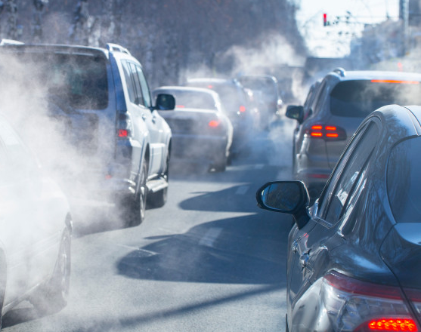
INTRODUCTION
Nitrogen dioxide (NO2) is a key pollutant linked to traffic emissions and industrial activity, significantly affecting urban air quality.
This study focuses on analyzing temporal trends in NO2 levels in Nairobi between 2019 and 2023, utilizing satellite imagery data from Sentinel-5P.
The analysis specifically targets the months of June to August, in which the county experiences cold weather conditions, providing insights into seasonal variations during these critical mid-year periods.
The study aims to uncover the trends in pollution by examining NO2 concentrations over this five-year span.

Slide 4
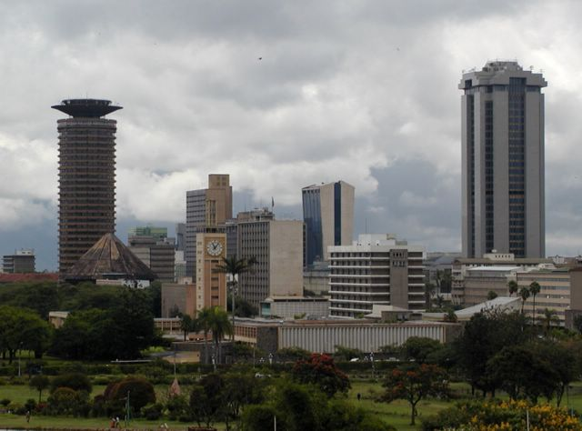
Nairobi County
Nairobi County, Kenya’s capital, is a vibrant urban center known for its economic, political, and industrial significance in East Africa.
It hosts a population exceeding 4 million, with a mix of residential, commercial, and industrial zones.
The county’s diverse land use, combined with its role as a major transport hub, contributes to substantial emissions, particularly from vehicles and industries.
Nairobi’s climate is generally tropical, with two rainy seasons, but the months of June to August are distinct for their cold, overcast weather.
These cooler months create atmospheric conditions that can trap pollutants, increasing air quality issues. The selection of this period for studying nitrogen dioxide (NO2) levels is key, as weather patterns during this time likely influence pollutant concentration and dispersion, making it an ideal window to assess NO2 variability in the county.
ThePhoto by PhotoAuthor is licensed under CCYYSA.

Slide 5
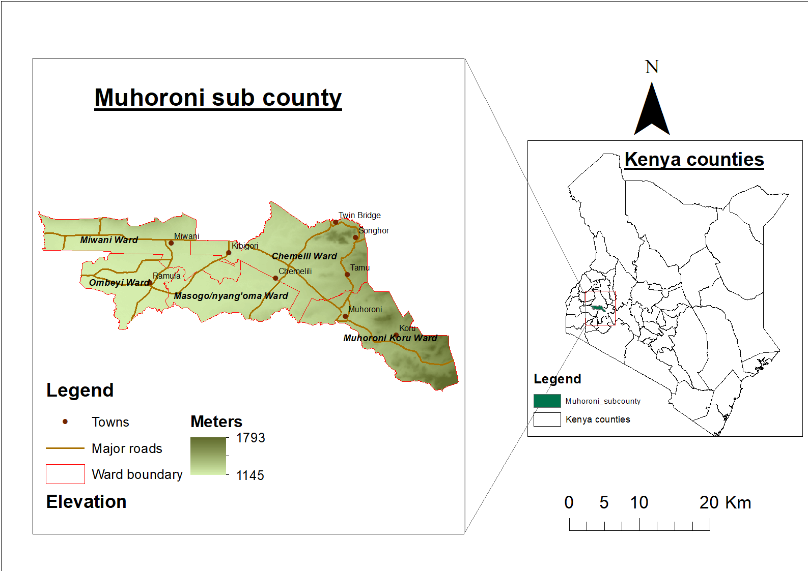
Nairobi County

Slide 6
Objectives
To analyze the temporal trends of nitrogen dioxide (NO2) levels in Nairobi County from 2019 to 2023, with a specific focus on the months of June to August.
To identify and quantify the year-to-year variations in NO2 concentrations in Nairobi County from 2019 to 2023.

Slide 7
Methodology
Data Collection: Satellite imagery data was collected from Sentinel-5P, focusing on nitrogen dioxide (NO2) levels in Nairobi County during the months of June to August from 2019 to 2023.
Data Analysis in Google Earth Engine (GEE): The satellite data was processed and analyzed in GEE, allowing for the extraction of NO2 concentrations over time. Temporal and spatial patterns were identified and prepared for further analysis.
Mapping in QGIS: The processed NO2 data was visualized using QGIS to create maps that display the spatial distribution of NO2 levels across Nairobi during the selected months. This step helped highlight geographic hotspots of NO2 concentration.
Trend Analysis in Excel: The extracted NO2 values were exported to Excel for further statistical analysis, where temporal trends over the five-year period were identified, and variations in NO2 levels were explored.

Slide 8
DATASETS USED
Sentinel-5P Satellite Data:
Source: The European Space Agency (ESA) provides Sentinel-5P satellite data through the Google Earth Engine (GEE) platform.
Dataset Description: The dataset focuses on atmospheric monitoring and includes measurements of trace gases such as nitrogen dioxide (NO2). The data is available at high temporal resolution, providing daily measurements of NO2 concentrations in the atmosphere.
Spatial Resolution: The spatial resolution for Sentinel-5P data is 7 km x 7 km, suitable for capturing regional NO2 distributions.
Temporal Range: The dataset covers the period from 2019 to 2023, with a focus on the months of June to August.

Slide 9
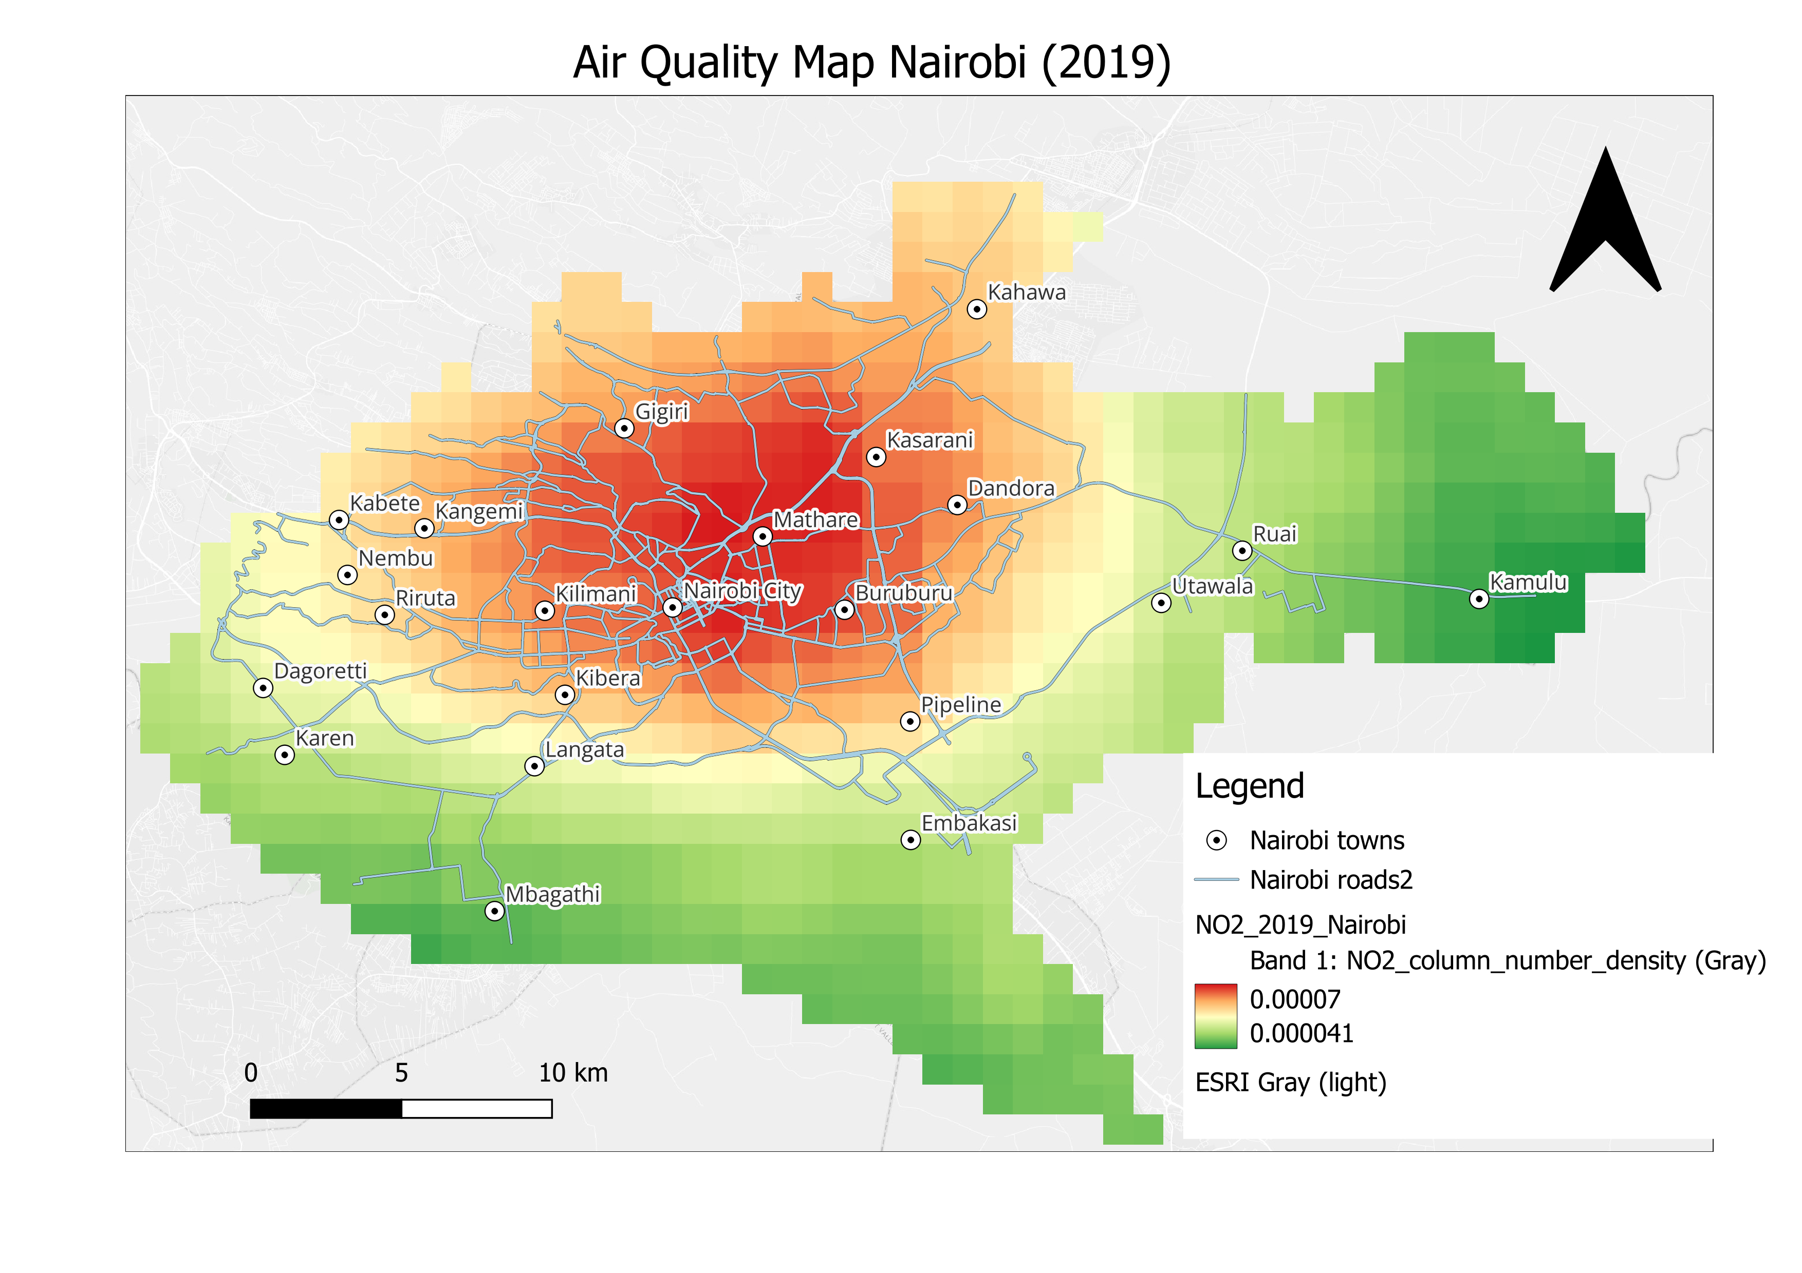
Results: 2019

Slide 10
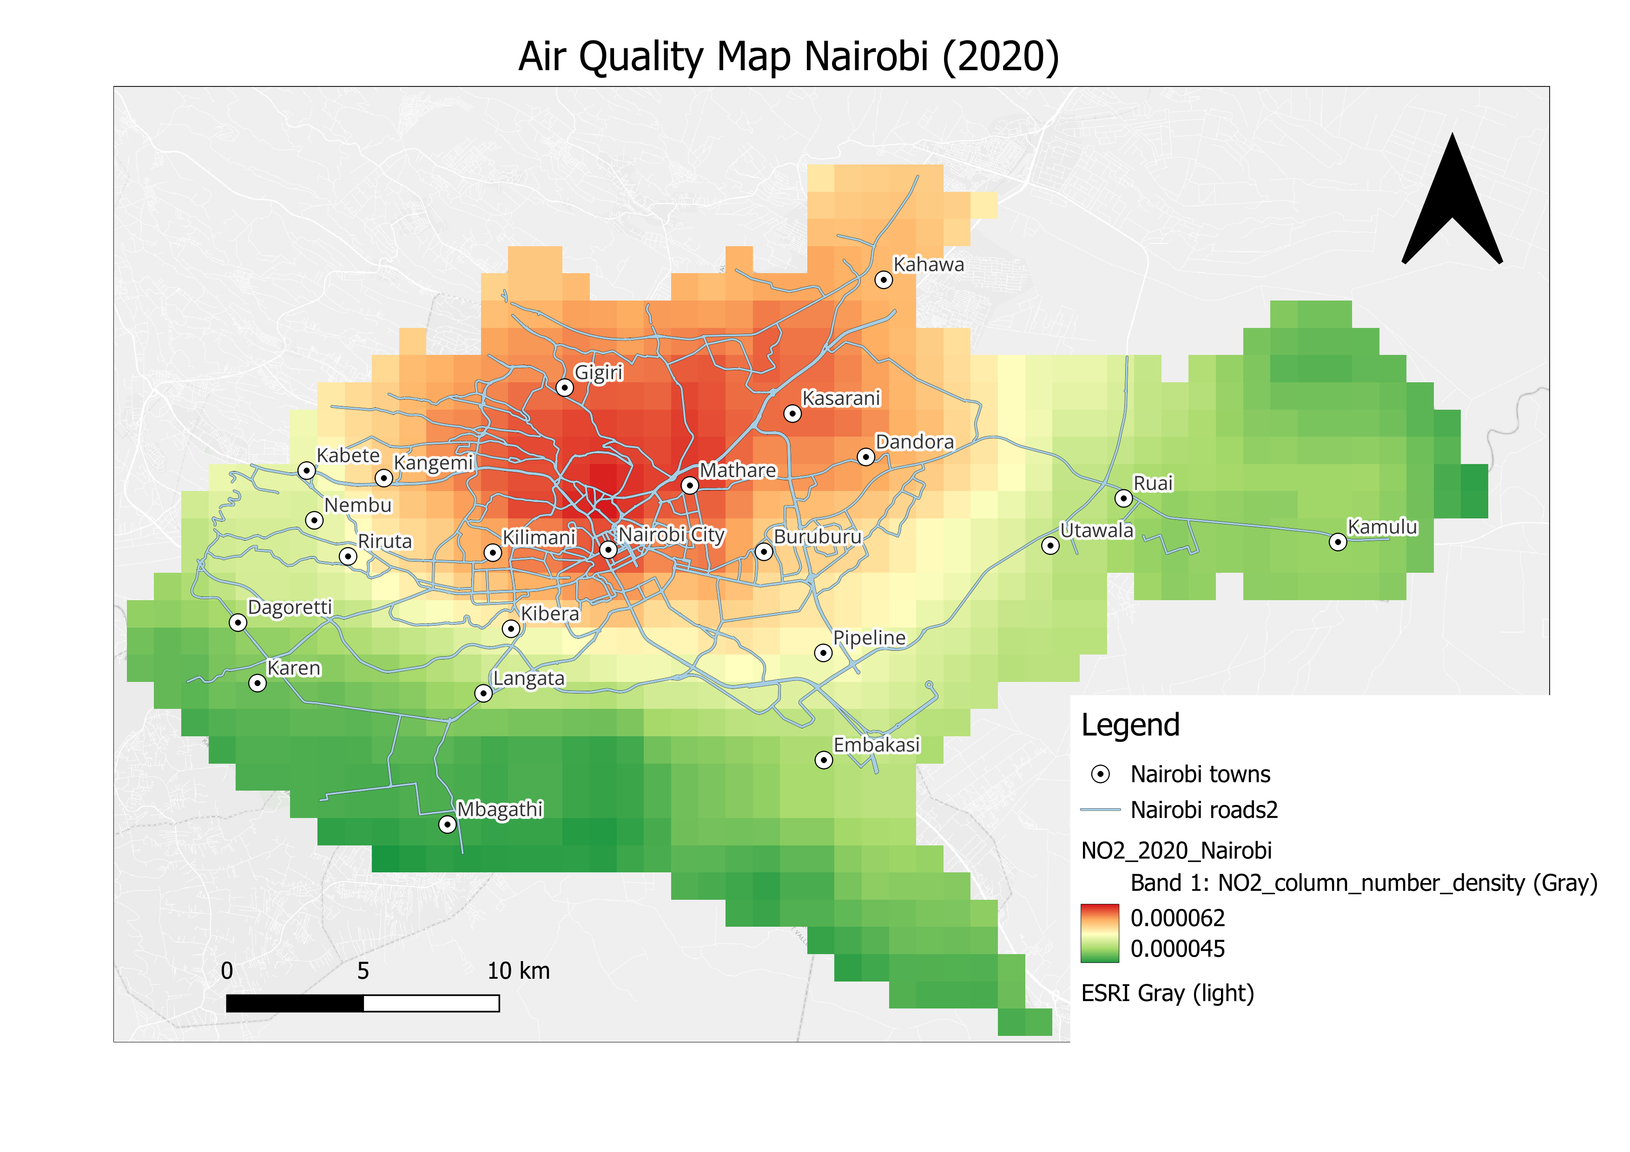
Results: 2020

Slide 11
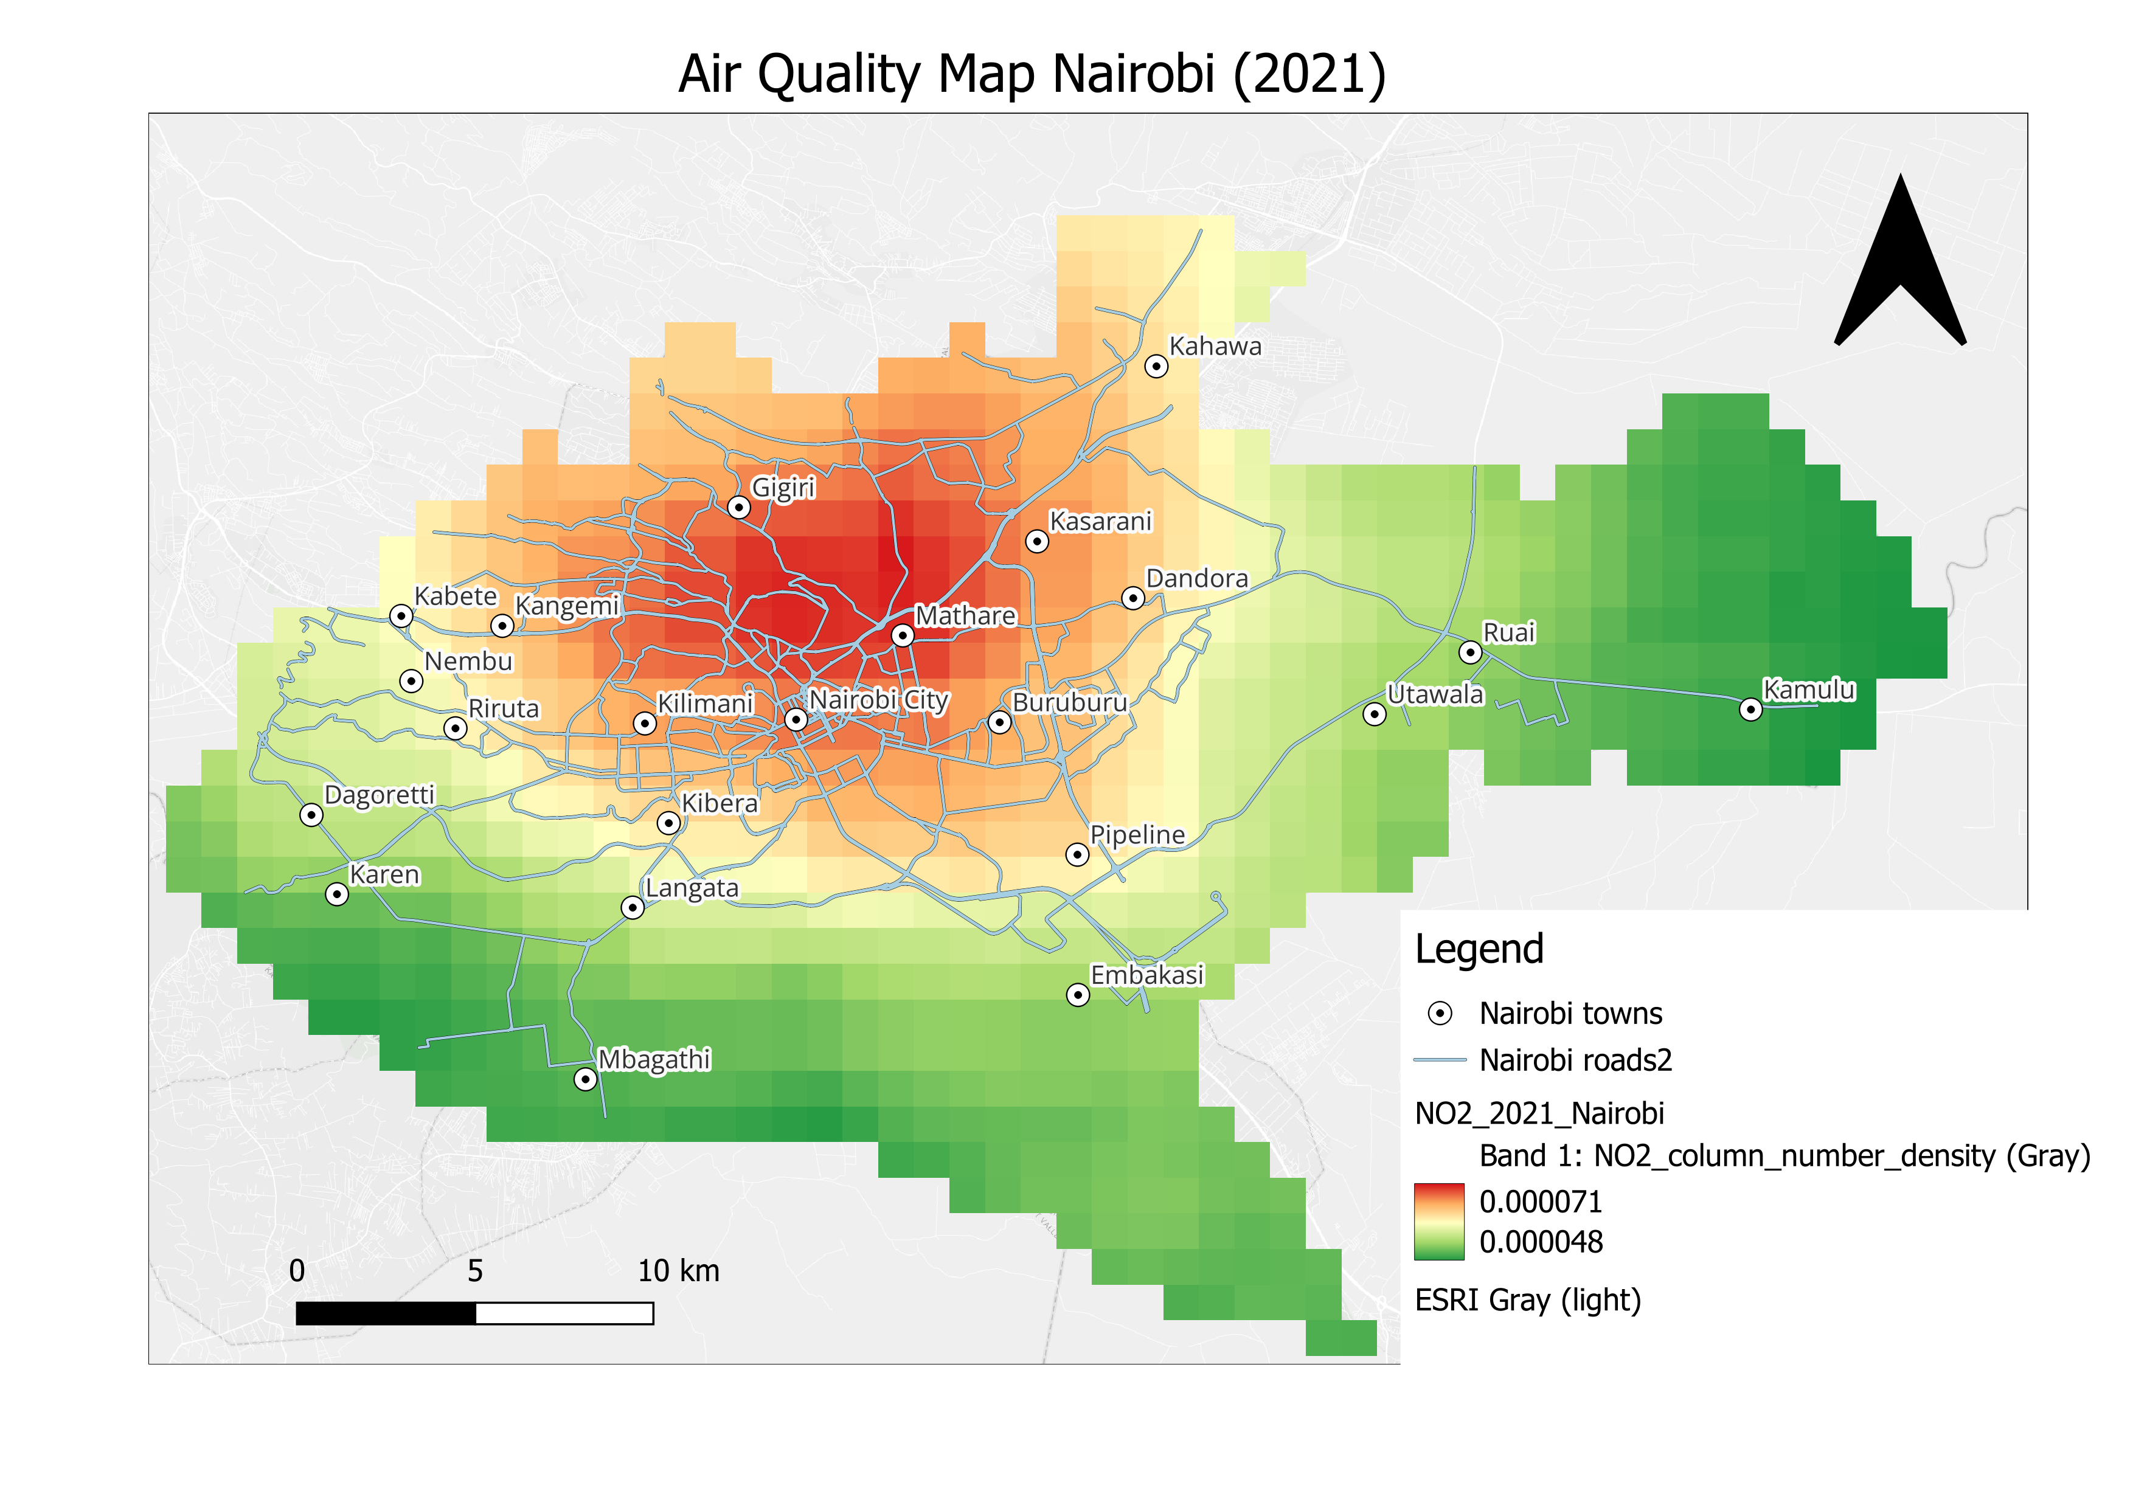
Results: 2021

Slide 12
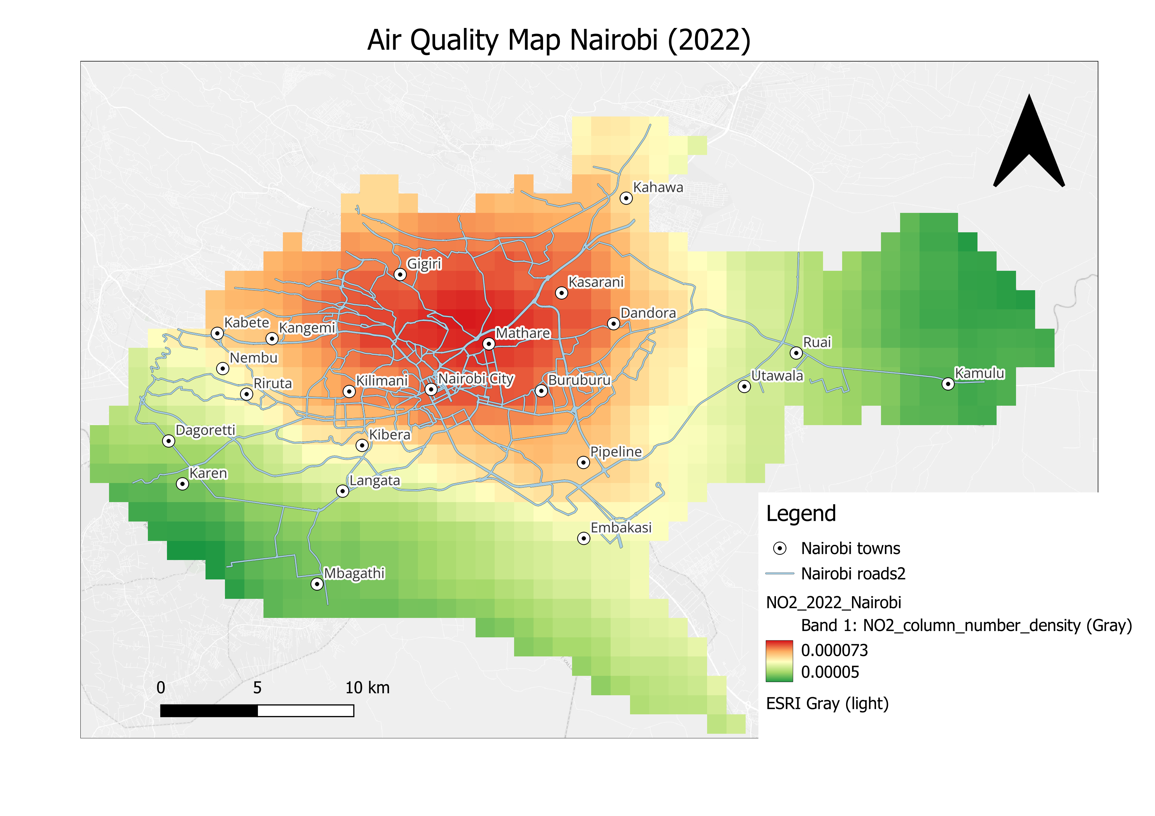
Results: 2022

Slide 13
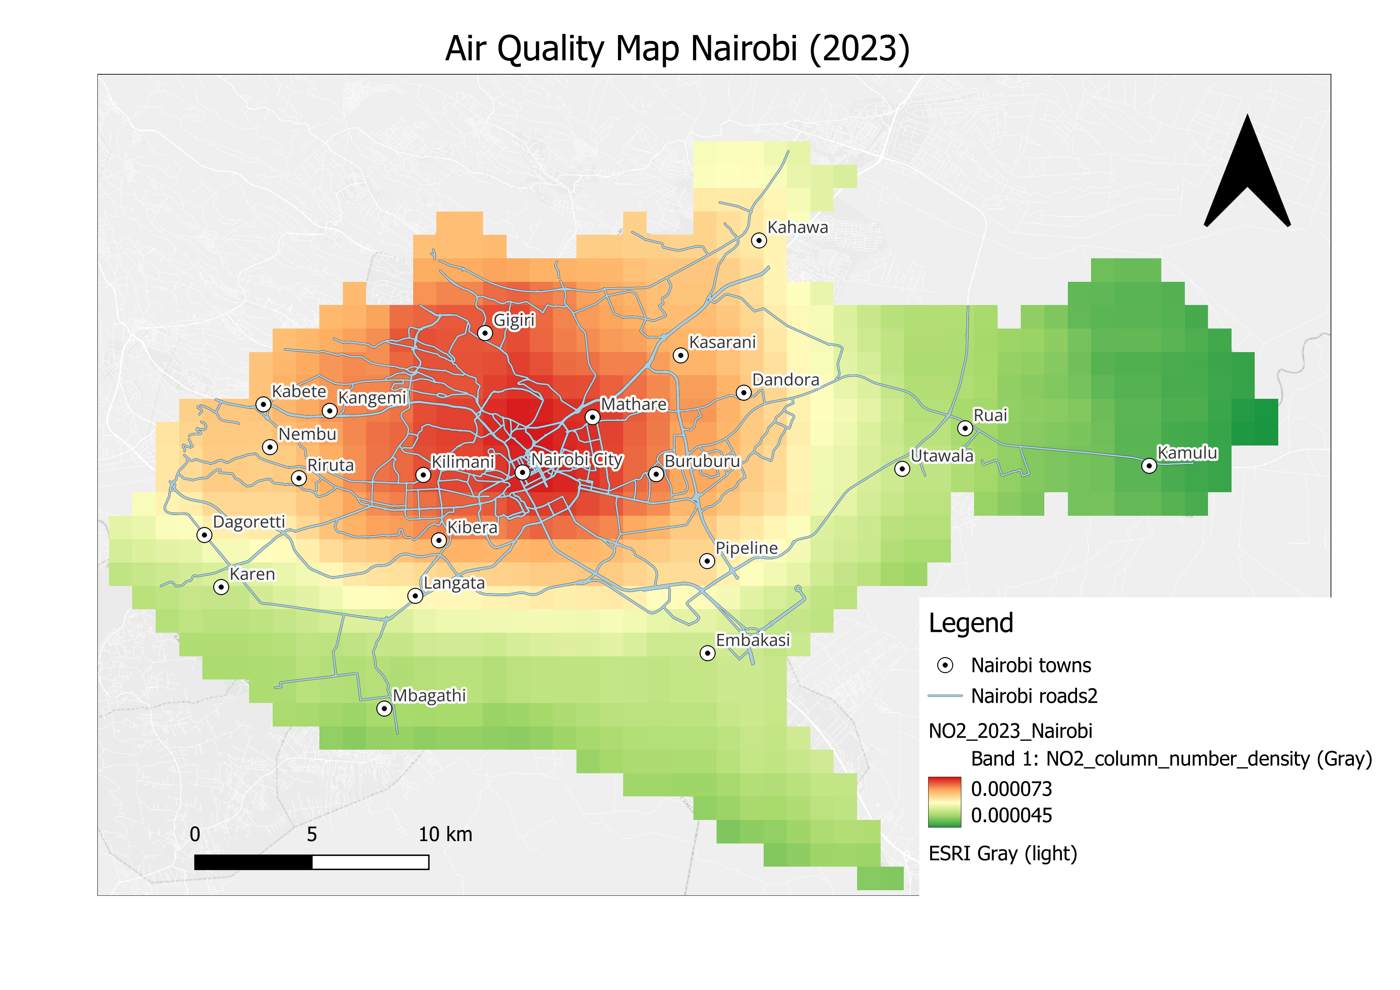
Results: 2023

Slide 14
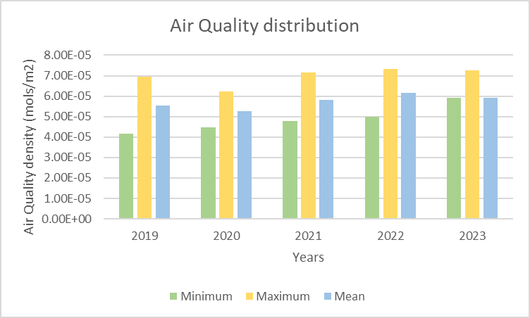
Results: Trends

Slide 15
Conclusion
The analysis reveals a steady increase in NO2 concentrations in Nairobi from 2019 to 2023, with the highest levels recorded in 2022.
This upward trend highlights the need for air quality management and mitigation strategies to address the growing air pollution in the city.
The seasonal cold weather conditions during June to August likely contribute to the trapping of pollutants, further exacerbating air quality challenges.
ThePhoto by PhotoAuthor is licensed under CCYYSA.

